Slide 1
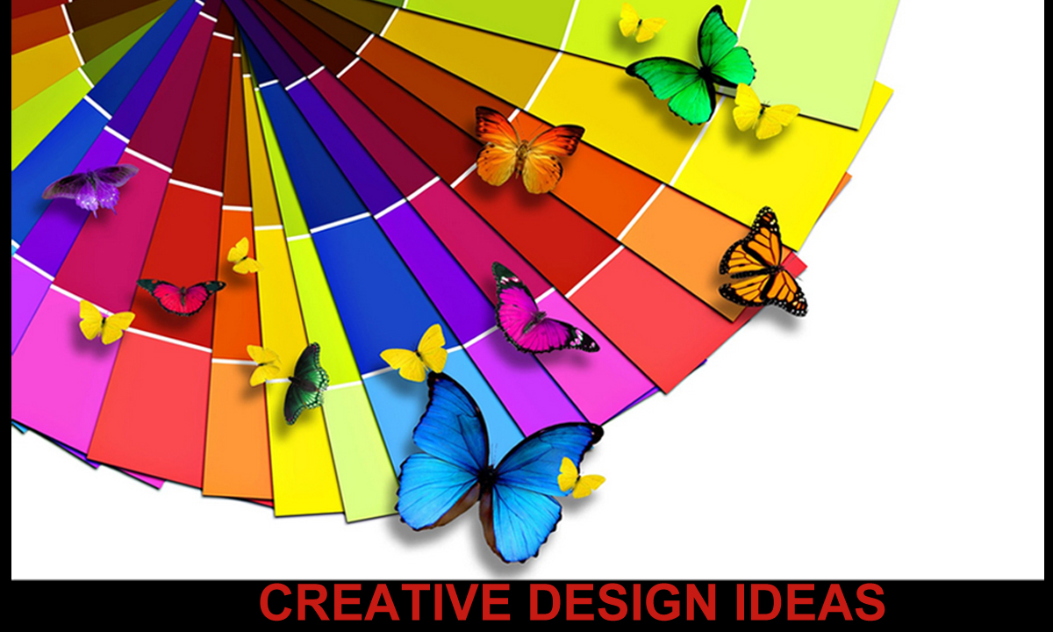

Slide 2
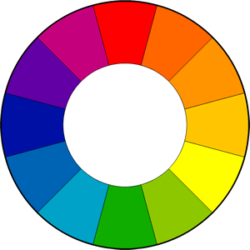
Basic color schemes
Introduction to Color Theory
The color wheel or color circle is the basic tool for combining colors. The first circular color diagram was designed by Sir Isaac Newton in 1666.
The color wheel is designed so that virtually any colors you pick from it will look good together. Over the years, many variations of the basic design have been made, but the most common version is a wheel of 12 colors based on the RYB (or artistic) color model.

Slide 3
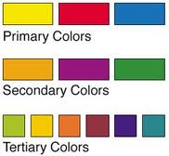
Primary, Secondary and Tertiary Colors
In the RYB (or subtractive) color model, the primary colors are red, yellow and blue.
The three secondary colors (green, orange and purple) are created by mixing two primary colors.
Another six tertiary colors are created by mixing primary and secondary colors.

Slide 4
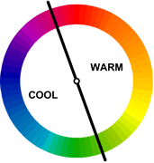
Warm and cool colors
The color circle can be divided into warm and cool colors.
Warm colors are vivid and energetic, and tend to advance in space.
Cool colors give an impression of calm, and create a soothing impression.
White, black and gray are considered to be neutral.

Slide 5
Tints, Shades, and Tones
These terms are often used incorrectly, although they describe fairly simple color concepts. If a color is made lighter by adding white, the result is called a tint. If black is added, the darker version is called a shade. And if gray is added, the result is a different tone.

Slide 6



Tints - adding white to a pure hue:
Shades - adding black to a pure hue:
Tones - adding gray to a pure hue:

Slide 7
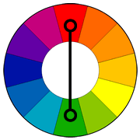
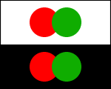
Color Harmonies
Basic techniques for creating color schemes
Below are shown the basic color chords based on the color wheel.
Complementary color scheme
Colors that are opposite each other on the color wheel are considered to be complementary colors (example: red and green).
The high contrast of complementary colors creates a vibrant look especially when used at full saturation. This color scheme must be managed well so it is not jarring.
Complementary color schemes are tricky to use in large doses, but work well when you want something to stand out.
Complementary colors are really bad for text.

Slide 8
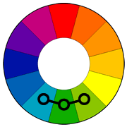
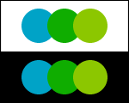
Analogous color scheme
Analogous color schemes use colors that are next to each other on the color wheel. They usually match well and create serene and comfortable designs.
Analogous color schemes are often found in nature and are harmonious and pleasing to the eye.
Make sure you have enough contrast when choosing an analogous color scheme.
Choose one color to dominate, a second to support. The third color is used (along with black, white or gray) as an accent.

Slide 9
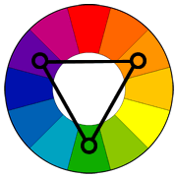
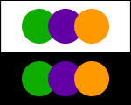
Triadic color scheme
A triadic color scheme uses colors that are evenly spaced around the color wheel.
Triadic color schemes tend to be quite vibrant, even if you use pale or unsaturated versions of your hues.
To use a triadic harmony successfully, the colors should be carefully balanced - let one color dominate and use the two others for accent.

Slide 10
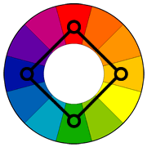
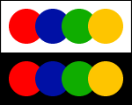
Square color scheme
The square color scheme is similar to the rectangle, but with all four colors spaced evenly around the color circle.
Square color schemes works best if you let one color be dominant.
You should also pay attention to the balance between warm and cool colors in your design.

Slide 11
DESIGNING TIPS & GUIDELINES
CHOOSING TYPOGRAPHY
WHITE SPACE
GRAMMER ,SPELL CHECK & PUNCTUATION
USING GRIDS FOR ALIGNMENT OF TEXT & IMAGES
ALIGNMENT,KERNING & TRACKING OF BLOCK TEXT
TEXT WRAP
DROP CAPS
COLUMNS
TABLES
USE OF GRAPHICS
ORIGINAL ARTWORK

Slide 12
TYPOGRAPHY
Use technology to make better font choices.
For your design project, head over to MyFonts.com tag section. Pick the word that best describes the style you’re looking for or use the search box in the top right corner to type a specific tag.
You will be presented with an array of typefaces that match the style you’re looking for while having the ability to type your own sample text. For example, you can pick the “restaurant” tag, type the restaurant name in the sample text box and instantly see some great fonts for your project.

Slide 13
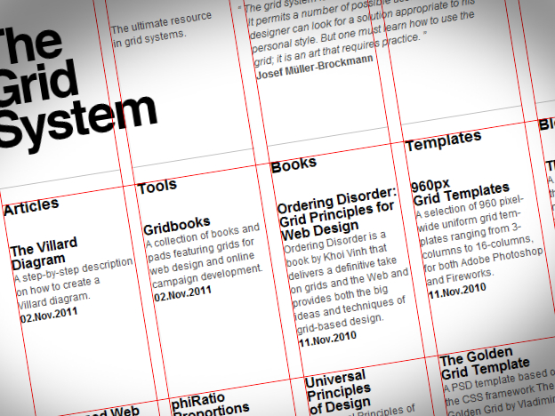
GRIDS
Learn to use the grid
Divide your artboard into several evenly spaced columns and rows, then use them as guides for your artwork placement. This enables you to focus on the creative part of your design work, such as concept, typography and atmosphere, while letting the grid guide your layout decisions.

Slide 14
Explore different palettes with free color generators
Colors can make or break your design by either making your audience want to stick around or look away. Well-chosen color combinations help designs catch attention more while the less planned ones do the opposite.
In fact, there are colors that work so bad together that they could literally hurt the eyes when you stare or would hinder you from understanding the accompanying texts or images. On the other hand, great color combinations don’t just help catch people’s attention; they help sustain interest as well.
However, even the best designers could run out of ideas sometimes. Good news is, there exists many color scheme generators that will help even the most uninspired to choose what colors to use.
Color Scheme Designer
Color Scheme Designer is an interactive tool for designing harmonious color schemes that lets you drag a scale around a color wheel to select your hues, adjust the scheme and then export the hex codes into HTML, XML or text.
Visit Site

Slide 15
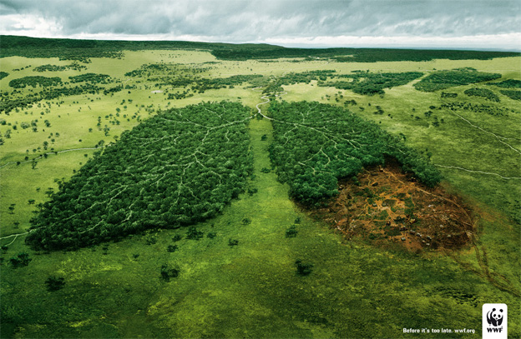
Design to tell a story
Great design is less about decoration and more about communication. What makes a designer famous is not the ability to create nice looking work – it’s the ability to send a message and get a point across effectively.
Environmental issues are often hard to explain, but this WWF ad is a classic example of good storytelling.

Slide 16
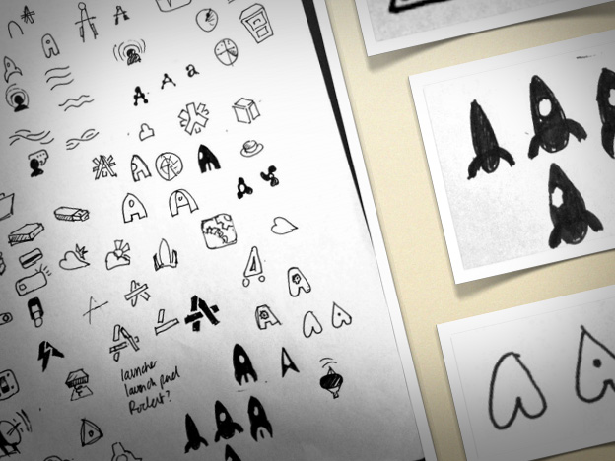
Use pen and paper while brainstorming
Starting your design project inside Photoshop or Illustrator can be a serious handicap for a number of reasons but most notably… loss of creativity.
Design programs weren’t made to explore design ideas and options, but to execute them once they’re already set. When you use them during the idea stage, you’re actually working incredibly slow – you need to worry about clicks, points, buttons, weights and swatches… none of which is required by your pen.
Also, you might be tempted to play with colors and effects which will only drive your attention away from the idea itself.

Slide 17
Never settle for one idea
I have a question – how do you know what’s good, until you’ve seen what’s bad? The answer is that you don’t, yet many designers make the simple mistake of settling with the first idea that comes to mind.
Always develop at least three, completely different, design ideas for your project… no matter how overwhelming this might seem. This will not only get the generic stuff out first but will give you something to compare and separate the good from the bad.

Slide 18
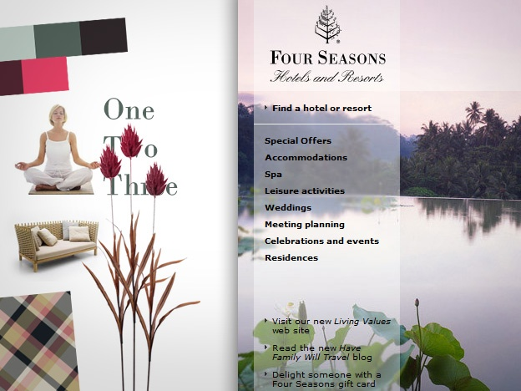
Use RIS approach to drive your design decisions
This is an acronym for Response – Imagery – Solution, which is a 3-step system for coming up with highly effective designs. This method works best for more complex design pieces such as brochures, websites and posters but it can be used for logo inspiration too.

Slide 19
Contd..
To elicit feelings of relaxation and luxury, Four Seasons uses imagery, colors, patterns and fonts which trigger such emotions.
You need to split your work into three distinct stages:
Response – which emotions and impressions do you want to elicit with your design? For example, if you’re doing a website for a popular ski resort, you might want to elicit emotions of joy and excitement while making people think the resort is upscale and prestigious.
Imagery – which images and visual elements can be used to stimulate such responses? Think in terms of colors, textures, photography, patterns and fonts. For our ski resort example, joy and excitement could be provoked with images of people skiing and having fun, while prestigious element can be introduced with big serif headlines, silvery-black palette, and perhaps slightly textured background. For this stage, it’s best to develop a mood board, but it’s not absolutely necessary.
Solution – develop the design concept based on your imagery and check to see if it makes people feel the way you intended them to.

Slide 20
Make a cover version of a popular design
Copying and imitation is generally bad for most purposes but it’s an excellent learning tool for beginners. Just as many musicians practice their skills by singing cover versions of popular songs, you can create cover versions of popular designs.
The task is simple – find a website, poster or logo design you really like, then try to reproduce it as well as you can. You can either make an identical replica, or change it to reflect your personal style.

Slide 21
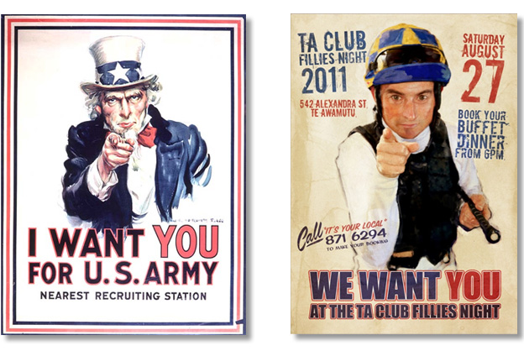
Contd..

Slide 22
Decorate your office – intelligently
Designers need inspiration and white walls will not give you much inspiration. However, instead of building a generic “creative” office which looks good but serves no purpose, why not decorate with practical items?For example, you could:
Print out your font library and hang it on a wall.
Create 20 color combinations you like and paint them on your ceiling.
Print out and frame common website or brochure layouts.
Buy a flipchart and use it to sketch ideas while standing.
This will create a stimulating environment which will get your juices flowing while providing you with references to typefaces, colors and other important elements.

Slide 23
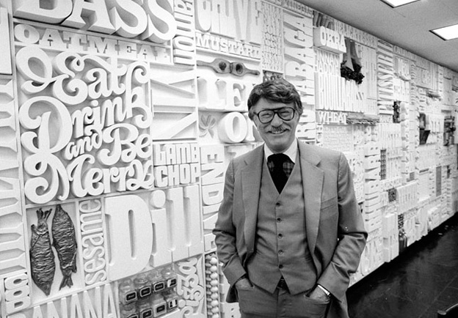
Contd..

Slide 24
Research more-
Google Search
When you don’t know a lot about the subject of your design, you are missing out on many ideas and opportunities.
Here are suggestions on what to search when exploring your design subject:
History & place of origin – for example, if you’re designing a logo for a “Cocoa place,” search for “Cocoa history” or “Cocoa stories” and see if you can find something interesting
Industry advertising – go to Google images, then search for “X ad,” X being your subject matter. You will see examples of your client’s industry advertising, which will give you some great insights into their design language
Localities - if your client’s product is localized or made for specific geographic market, explore that location
Facts and figures – type into Google what you’re interested in, followed by the word “facts.” You will narrow down your results to easily digestible blog posts and articles, perfect for quick introductions to less familiar subjects

Slide 25
Learn to draw
Knowing how to draw will make you twice as good and valuable because there are certain design problems that are best solved with this basic artistic skill.

Slide 26
Learn to (copy)write
Designers often overlook the importance of writing skills in their work, yet messages and communication are the reason graphic design exists in the first place.

Slide 27
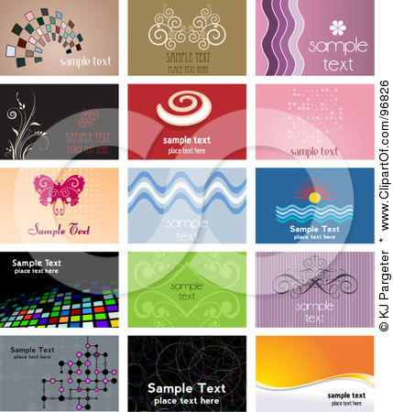
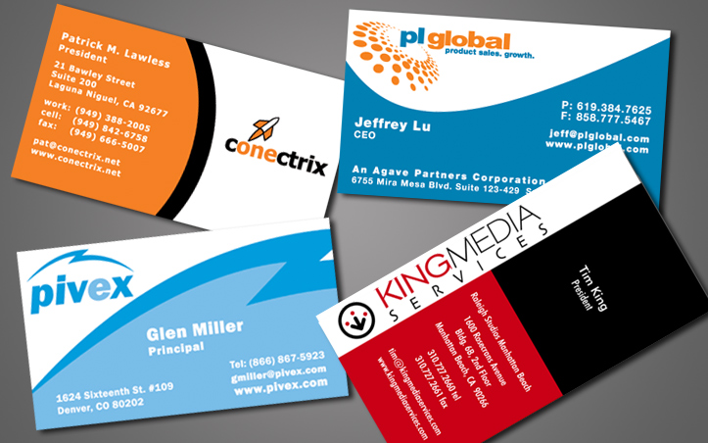
VISITING CARD DESIGN

Slide 28
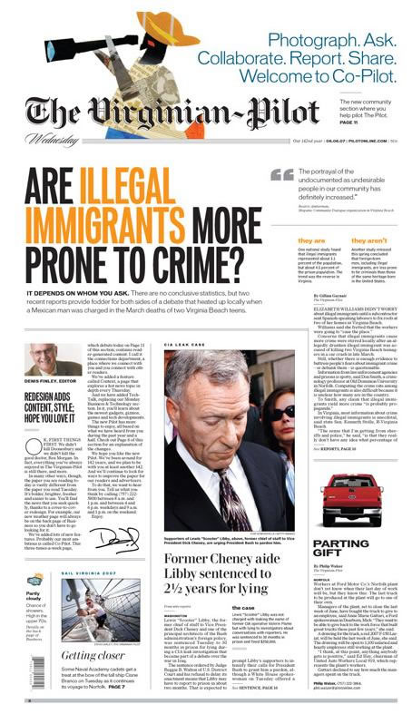
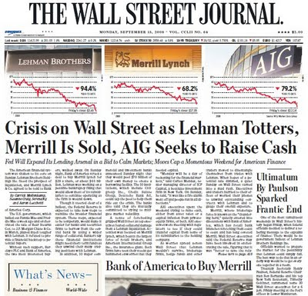
NEWSPAPER LAYOUT

Slide 29

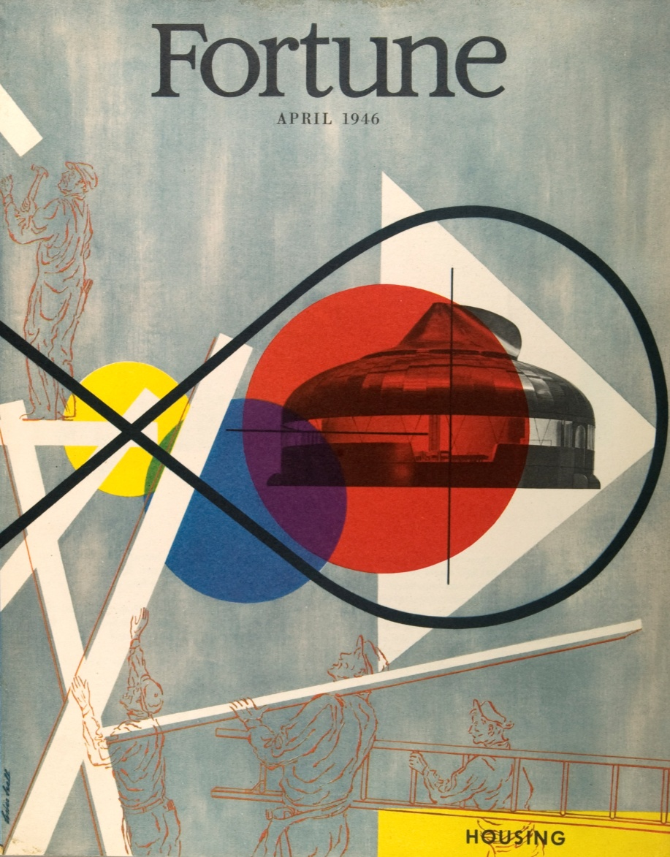
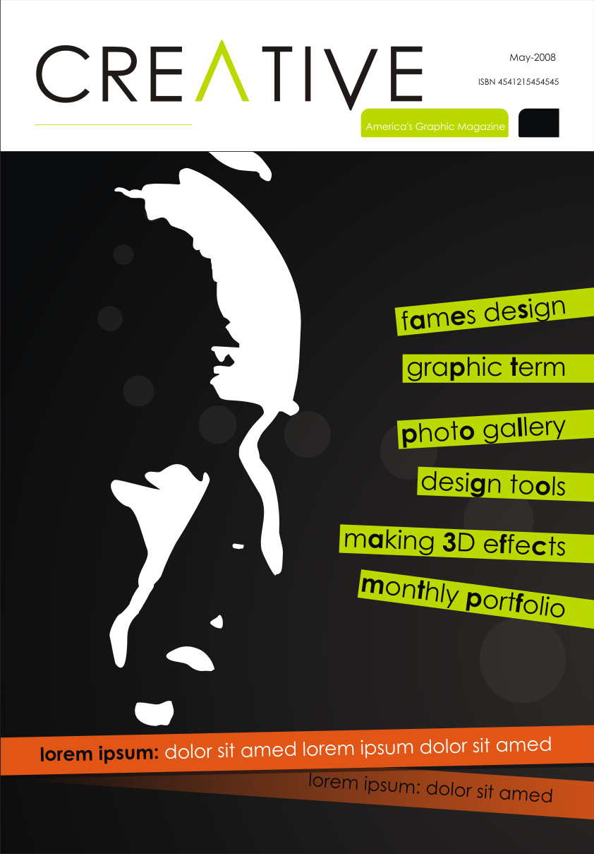
MAGAZINE COVER DESIGN

Slide 30
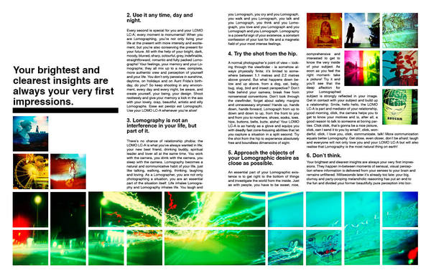
MAGAZINE LAYOUT

Slide 31
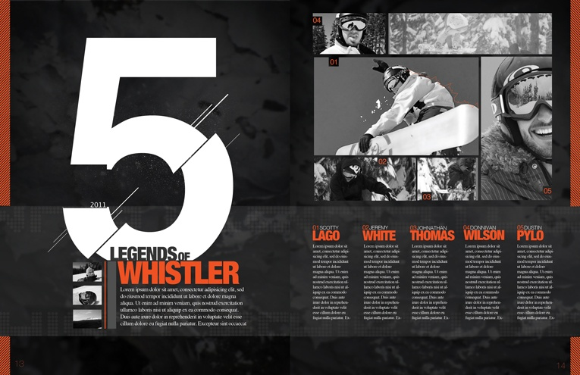
MAGAZINE LAYOUT

Slide 32

MAGAZINE LAYOUT

Slide 33


ADVERTISEMENT DESIGN

Slide 34
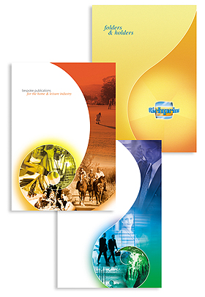
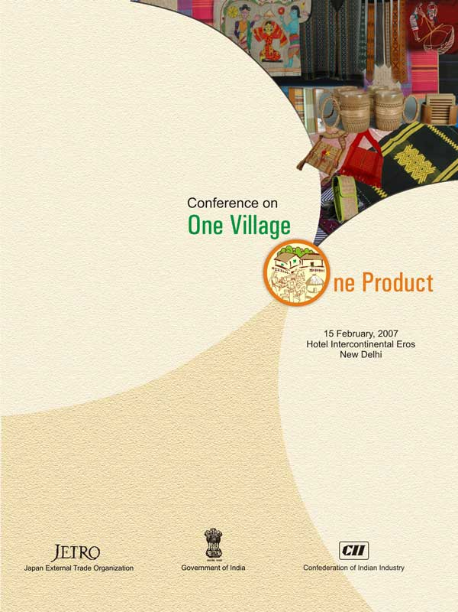
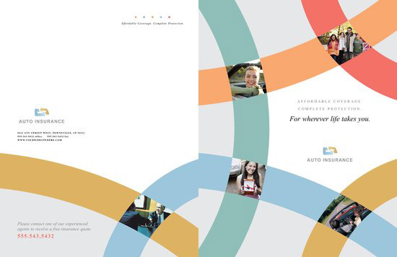
BROUCHURE DESIGN

Slide 35
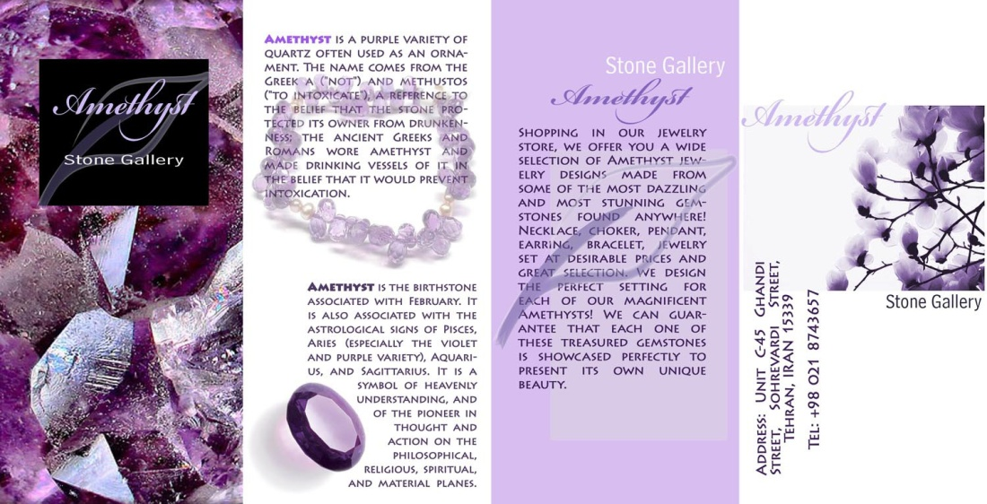
BROUCHURE DESIGN

Slide 36
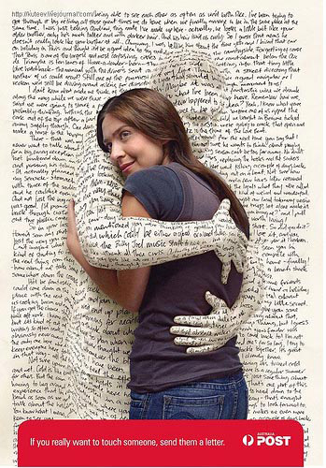
CREATIVE ADS

Slide 37

CREATIVE ADS

Slide 38
Information graphics
Information graphics or infographics are graphic visual representations of information, data or knowledge intended to present complex information quickly and clearly

Slide 39
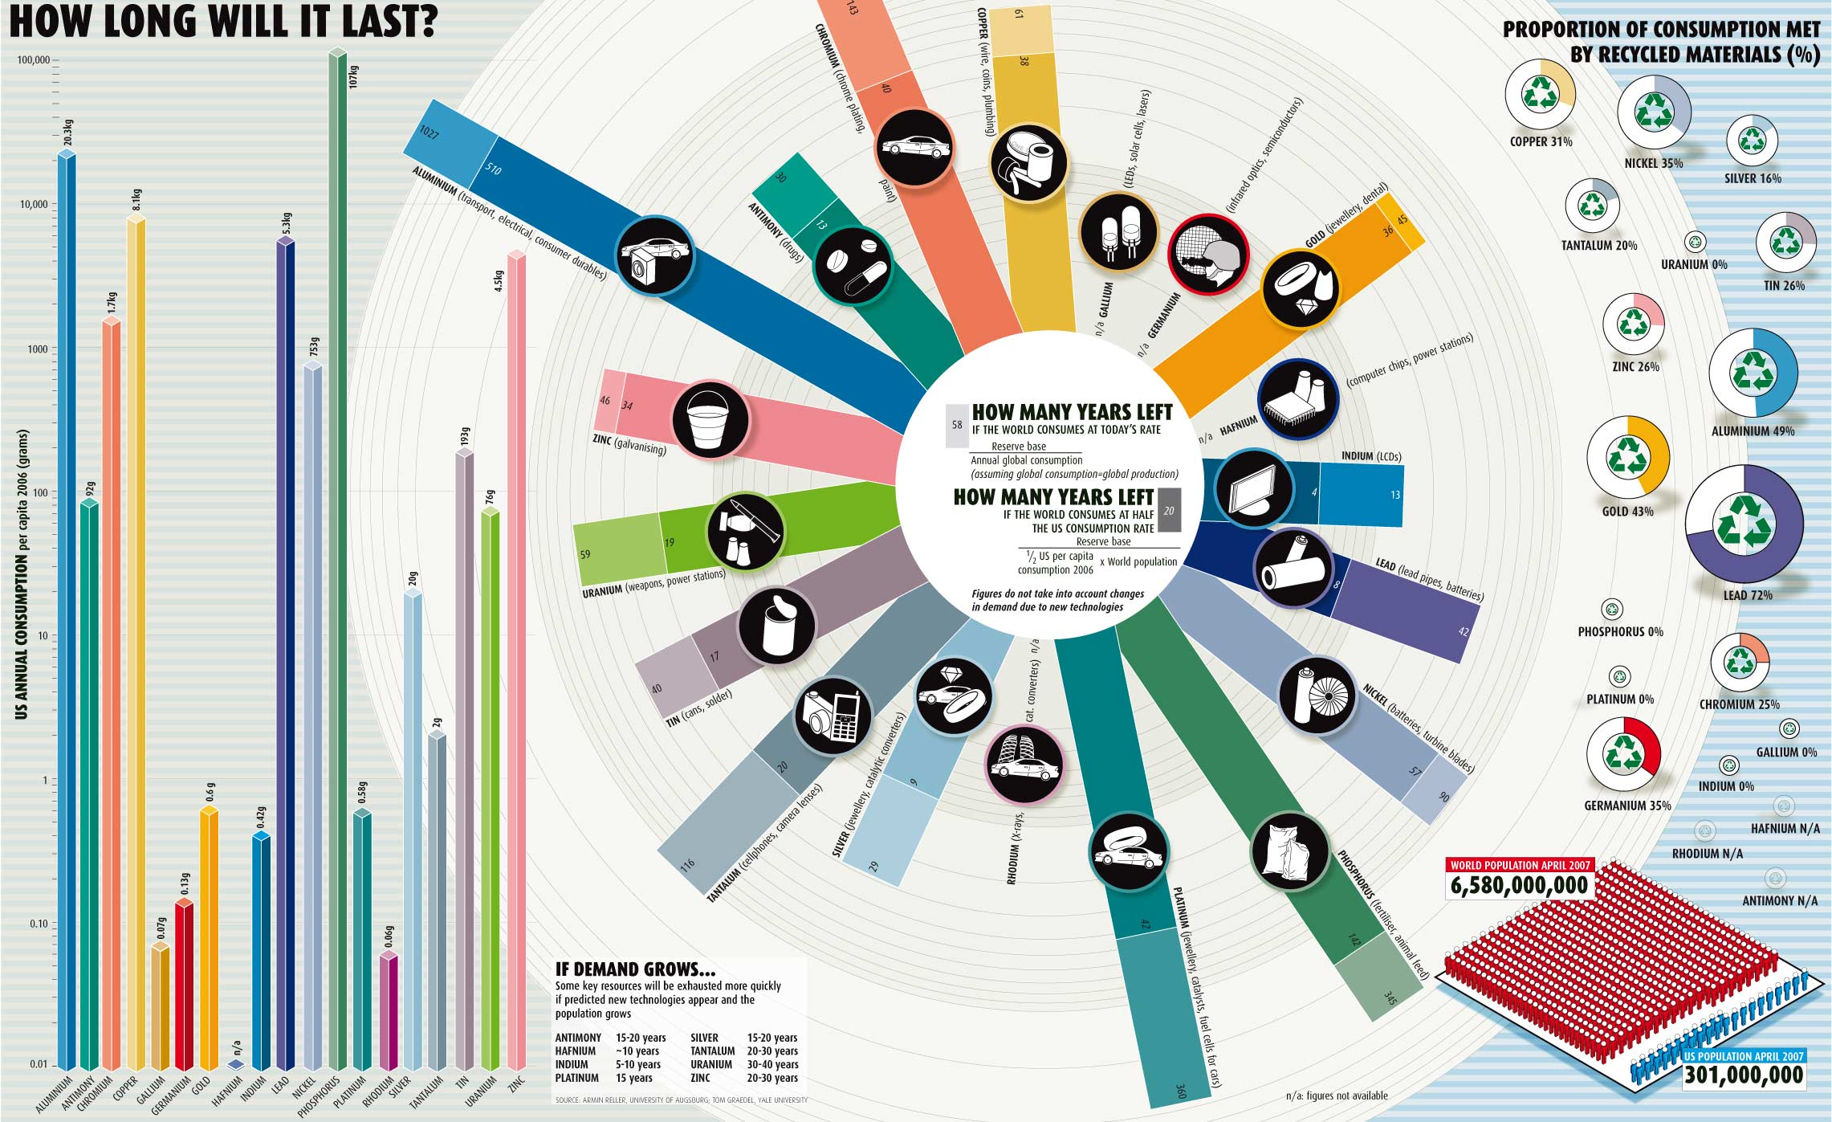
Information graphics

Slide 40
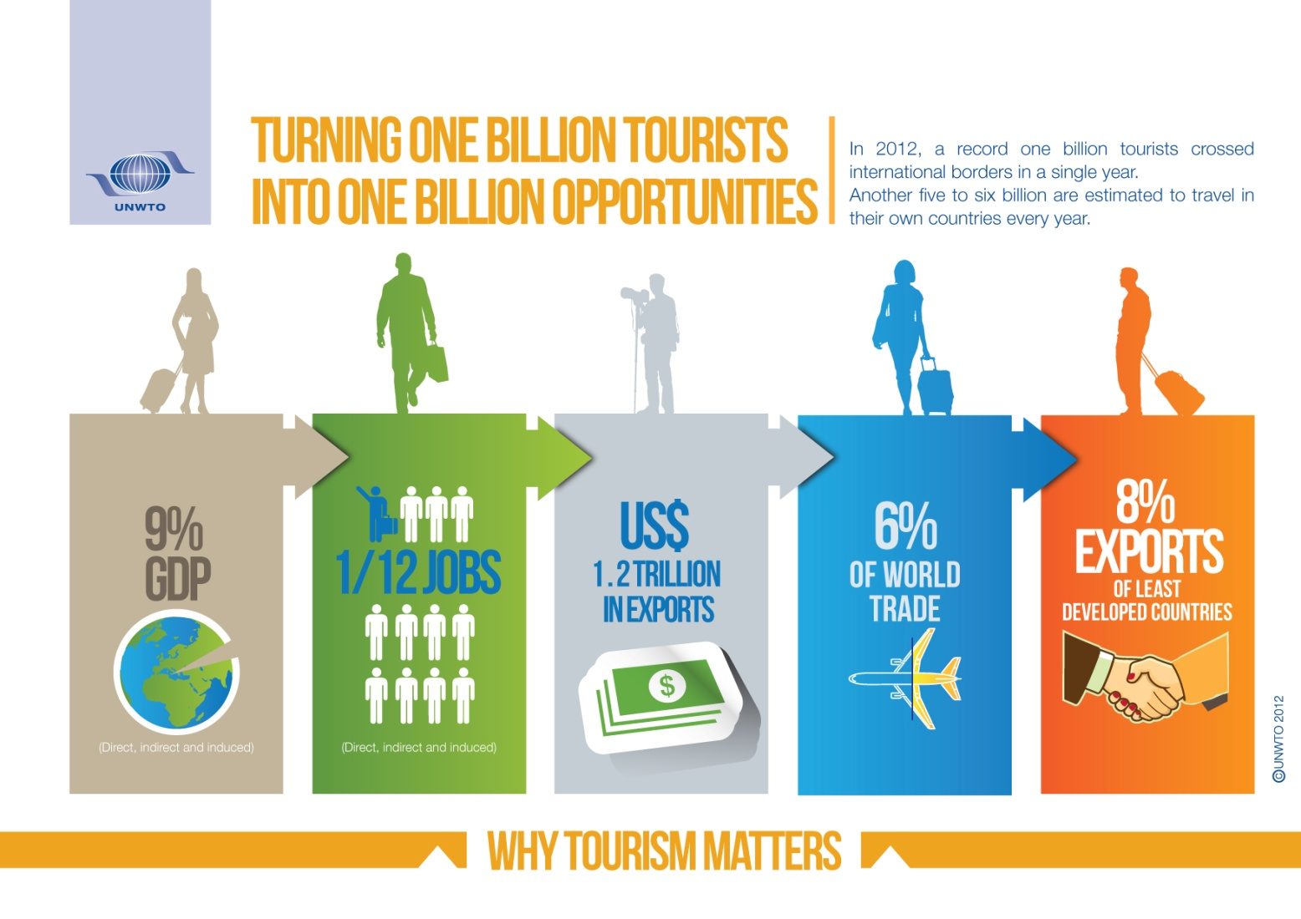
Information graphics

Slide 41
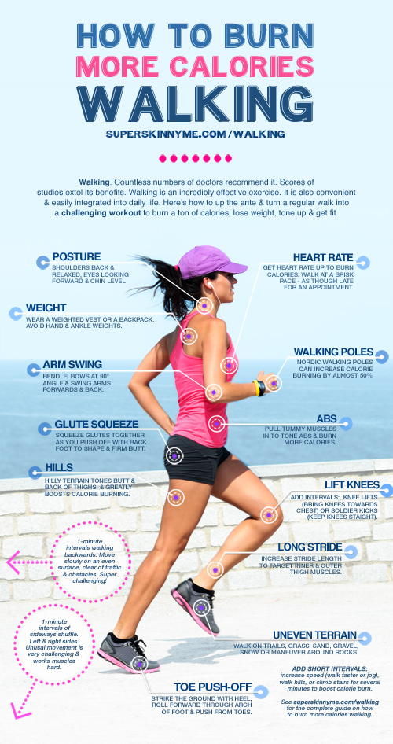
Information graphics

Slide 42
THANK YOU

